Slide 1
Agenda
Introduction,
Monolith vs Microservice architecture
Microservice characteristics an principles
case study example.

Slide 2
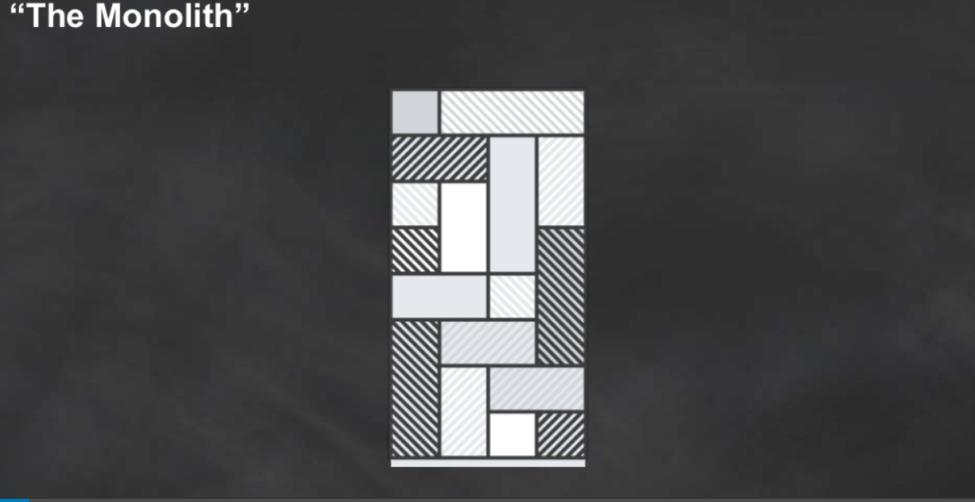
Monolith Webservcie

Slide 3
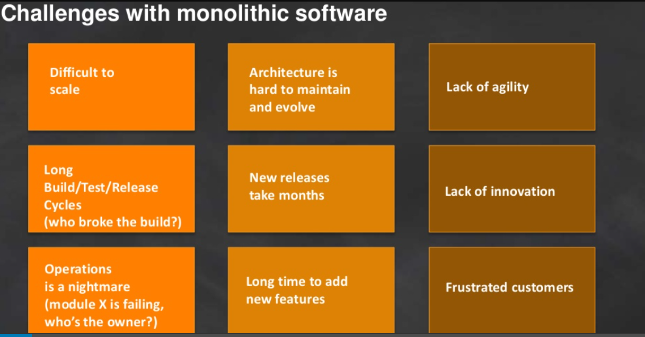

Slide 4
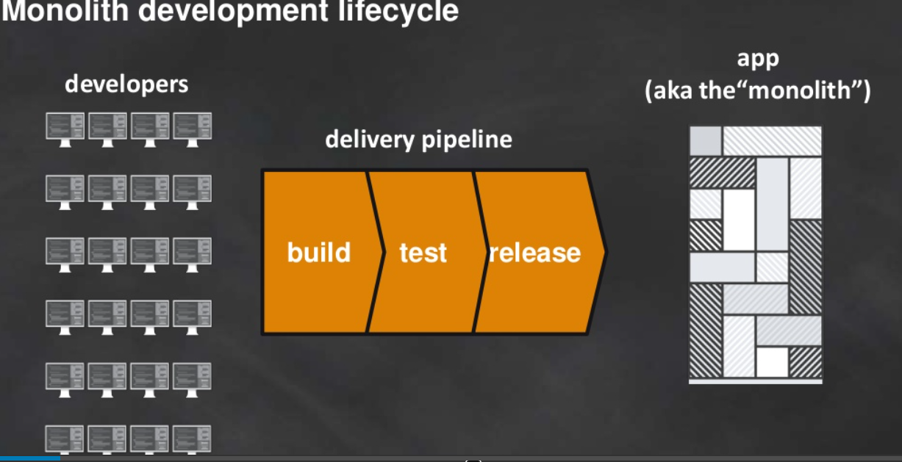

Slide 5
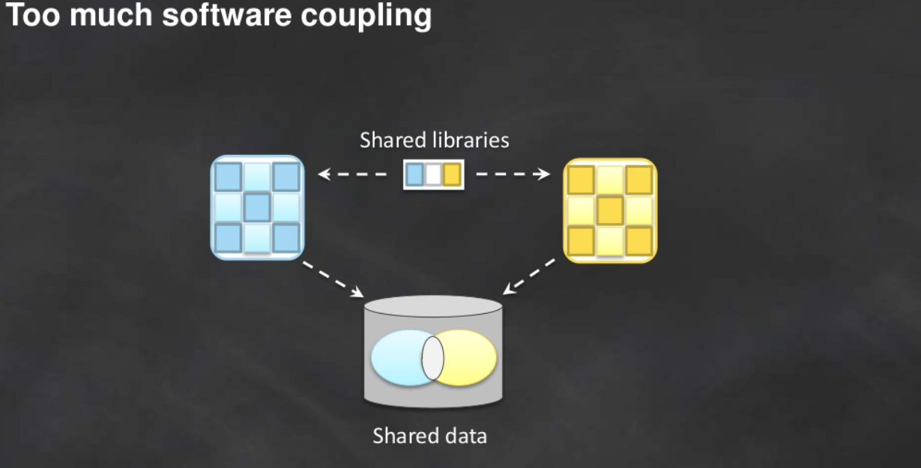

Slide 6
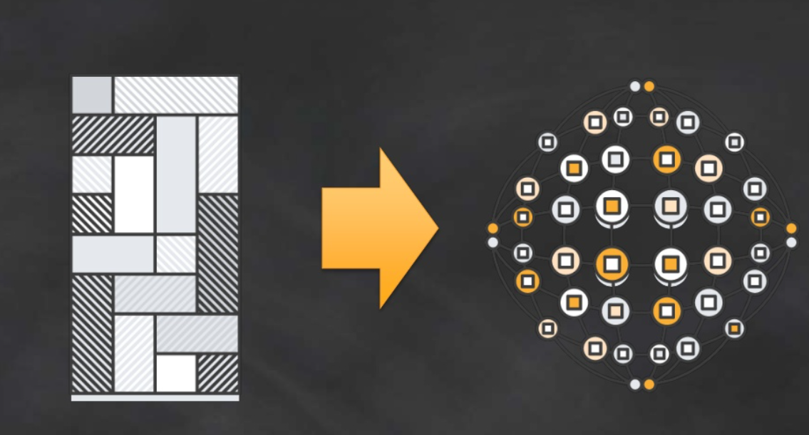
Monolith to Microservice

Slide 7
Microservices Characteristics
Componentization via Services. ...
Organized around Business Capabilities. ...
Products not Projects. ...
Smart endpoints and dumb pipes. ...
Decentralized Governance. ...
Decentralized Data Management. ...
Infrastructure Automation. ...
Design for failure.

Slide 8


Slide 9


Slide 10
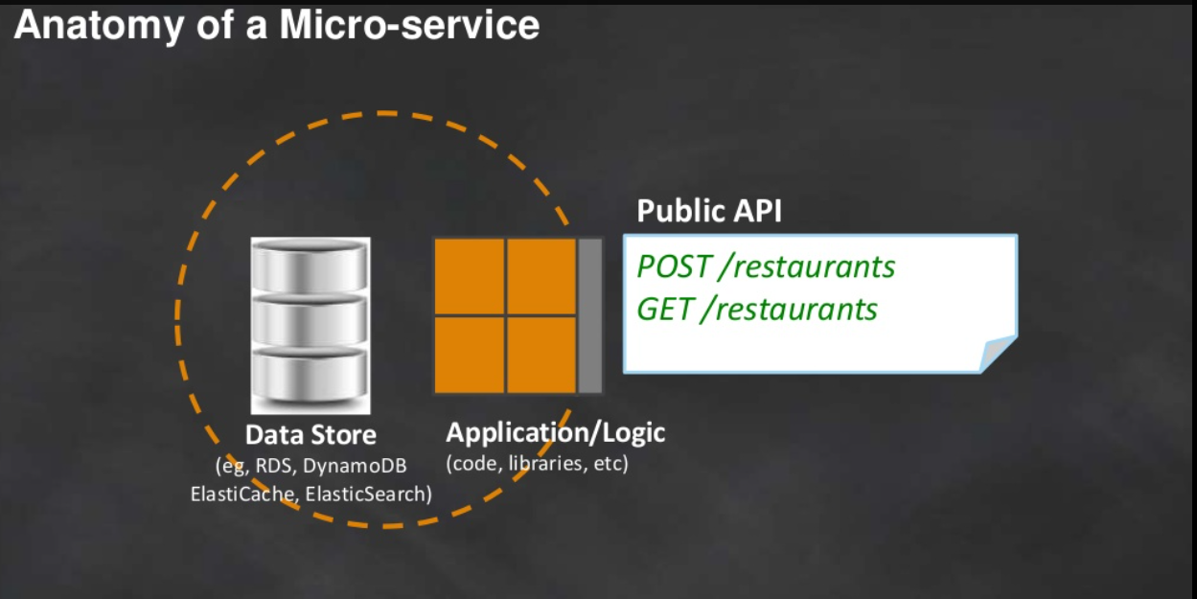

Slide 11
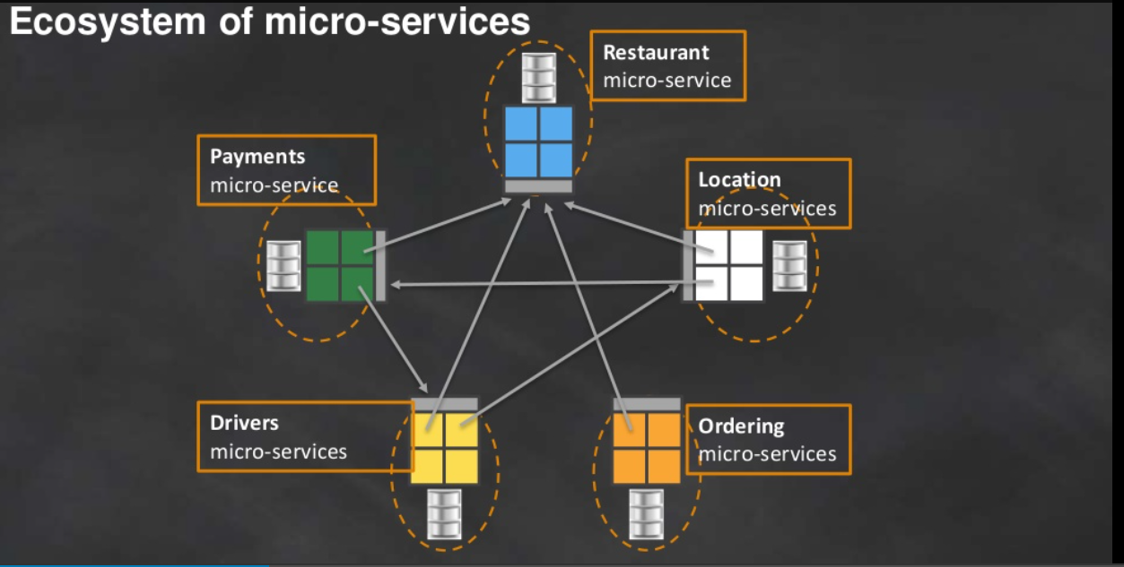

Slide 12
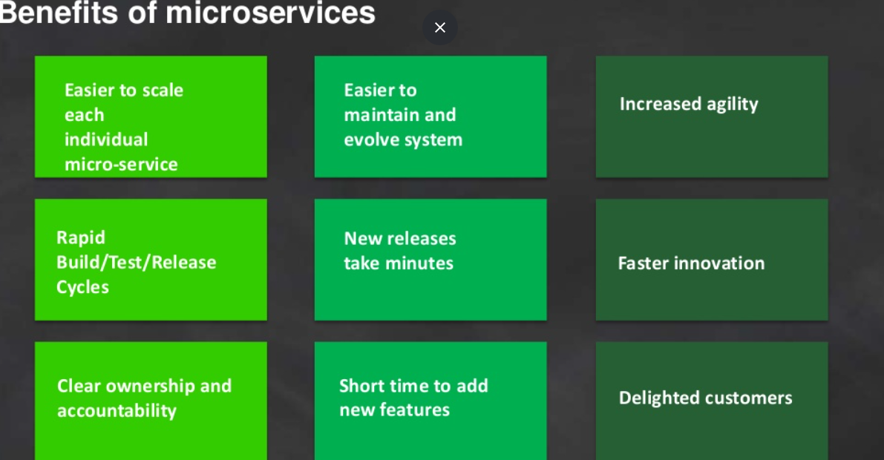

Slide 13
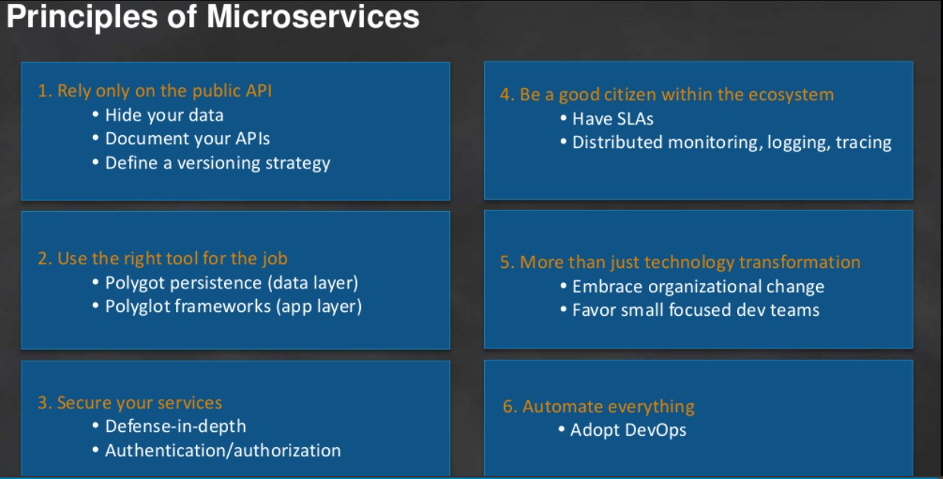

Slide 14
12 Factor principles
1.One codebase per service,
2.Dependencies,
3.Configuration,
4.Backing Services
5.Build,Release,Run,
6.Processes,
7.Data Isolation
8.Concurrency,
9.Disposability,
10.Dev/Prod Parity
11.Logs,
12.Admin processes

